Slide 1
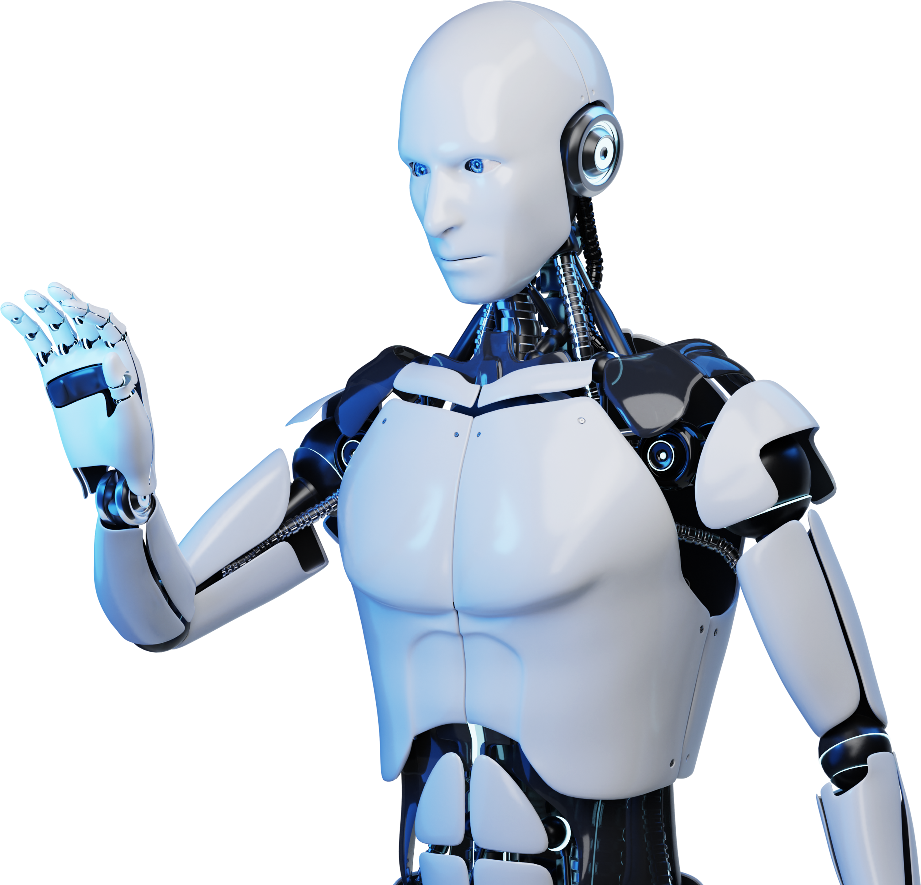
Online Chatbot based Ticketing System

Slide 2
Table Of Contents
01. Introduction of AI Chatbots
02. Overview of the system
03. Key Features
04. Problem and Solution Domain
05. The AI Revolution Hits museums
06. Existing Projects and research
07. Hardware, Software and Data
Requirements
08. System Architecture
09. How our project works
10. Mathematical Model

Slide 3
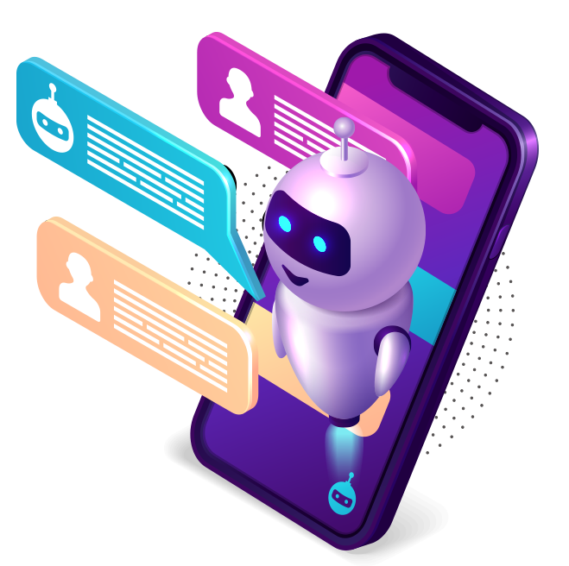
INTRODUCTION OF AI CHATBOTS
AI chatbots are intelligent software programs that simulate human conversations through text or voice. They leverage Natural Language Processing (NLP) and Machine Learning (ML) to understand user intent and provide instant responses. These chatbots can handle multiple queries simultaneously and gather valuable user data. They enhance customer experience by providing quick support, reduce operational costs, and ensure consistent communication.

Slide 4
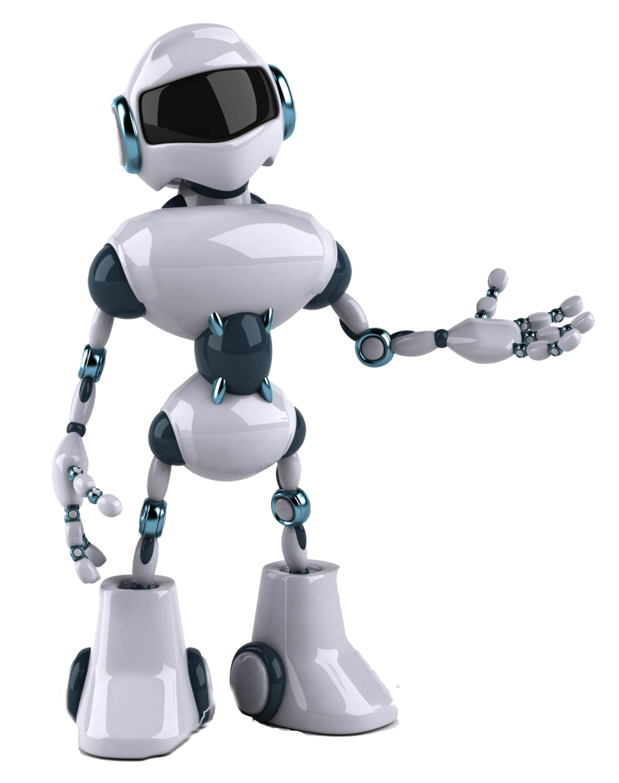
OVERVIEW OF THE SYSTEM
The Online Chatbot-based Ticketing System is designed to streamline the ticket booking process for museums, addressing inefficiencies commonly found in manual systems. This system allows visitors to interact with an AI-powered chatbot to book tickets quickly and easily. By automating and digitizing the process it will positively impact the museum’s reputation and visitor turnout.

Slide 5

KEY FEATURES
Improved Customer Service.
Cost-Effective Solution.
Data Collection and Analysis.
Reduced Human Error.
Enhanced Marketing and Promotion.
Efficient Handling of High Volumes.
Multilingual Support
Accessibility

Slide 6

PROBLEM DOMAIN
Information Access and Understanding
Problem: Museums often have a wealth of information, but visitors may not always have access to detailed descriptions
Impact: Visitors leave without fully understanding or appreciating the significance of the exhibits and struggle to get in-depth knowledge of what's provided in brochures.
Personalized Visitor Experiences
Problem: Museums attract diverse visitors each with unique interests and information needs.
Impact: A lack of personalization can result in disengaged visitors, reducing the impact of the visit.
​
Multilingual and Inclusive Communication​
Problem: International tourists with accessibility needs may find it hard to interact with museum staff or interpret exhibit information since not all museums have multilingual staff.​
Impact: Language barriers can reduce the overall enjoyment of the museum experience.

Slide 7

Seamless Ticketing, Event Information Alerts
Problem: Visitors need quick and accurate access to information about upcoming events, ticketing options, or last-minute changes which might frustrate visitors.
Impact: Can result in lost engagement opportunities and negative impressions if visitors miss out on experiences or events.
Handling Peak Hours and Crowd Management
Problem: Museums can become crowded during peak hours due to which visitors might experience long wait times for assistance, ticketing, or directions.
Impact: Poor crowd management leads to frustration and reduces visitor satisfaction.
.
Real-time Assistance for Frequently
Asked Questions
Problem: Visitors often have common questions about tickets, events, facilities, or directions due to which Museum staff may be overwhelmed by repetitive inquiries, making it hard to attend to more complex visitor needs.
Impact: Visitors may feel frustrated if they have to wait for basic information or staff attention.
Operational Efficiency and
Staff Support
Problem: Museum staff are tasked with both routine visitor interactions and critical operations, such as exhibit management.
Impact: Answering repetitive questions distracts staff from focusing on complex tasks like handling emergencies.

Slide 8
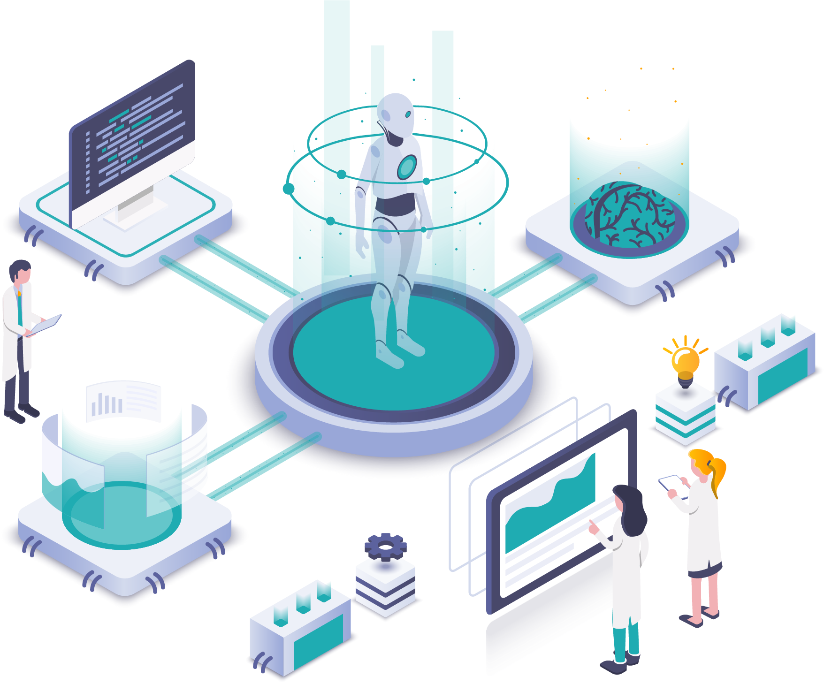
SOLUTION DOMAIN
How This Solution Addresses the Problem Domain
Given the problem of providing visitors with instant, personalized assistance through an AI-based chatbot, this setup ensures:
Real-time interaction via the Streamlit web interface.
Scalable backend with Flask/Dockerized language models that can handle multiple requests efficiently.
Data persistence using volume mapping to store important data or cache responses for quick access.
Flexible deployment as the Flask/Docker setup can run locally or in the cloud, depending on the museum's infrastructure.

Slide 9
1
Reducing Staff Workload by Handling Routine Queries
Visitors interact with the Streamlit app to get quick answers to routine questions (e.g., “Is the museum open tomorrow?”).
Ollama backend handles these queries automatically without staff involvement.
3
Navigation and Way finding within the Museum
Visitors ask questions through the Streamlit app, like “How do I get to the art gallery?”
Ollama processes the request and provides navigation instructions.
Directs visitors to specific exhibits, restrooms, cafes, or exits.
2
Ticketing and Event Updates Integration
Visitors can ask for ticket or event details through the Streamlit app and fetches the relevant information through the Ollama container.
Provides real-time ticket availability and helps visitors book tickets.
Sends notifications or alerts about upcoming events, exhibitions, or last-minute changes.
4
Personalized Exhibit Recommendations
User interacts with the chatbot via Streamlit to describe their interests (e.g., “I love ancient artifacts”).
Ollama backend uses machine learning to analyze user input and recommend relevant exhibits.
Improves visitor satisfaction by guiding them to events they like.

Slide 10
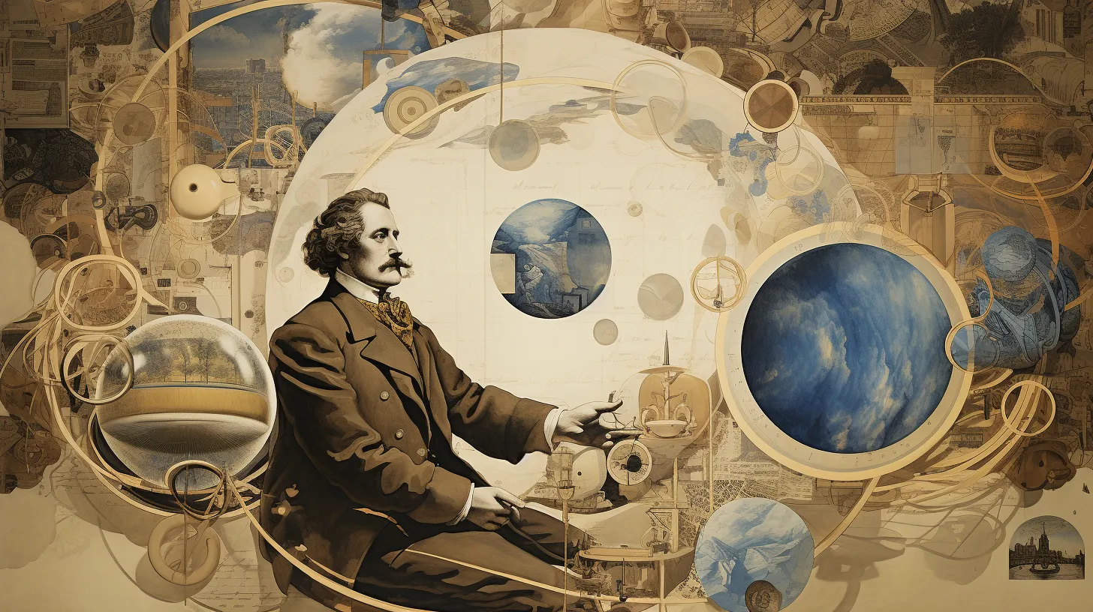
The AI Revolution Hits Museums
Chatbots Are Transforming the Visitor Experience
Chatbot makes museums more attractive to the younger generation of visitors, who use digital devices and social networks almost continuously during the day
When a visitor asks the chatbot a question, NLP analyzes the text to extract meaning. It interprets the intent and contextual nuances that humans intuitively understand in language. Based on this analysis, the AI generates conversational responses using a vast knowledge base provided by the museum.

Slide 11

Existing Projects and Research
The Anne Frank Museum in Amsterdam :
In 2017, the museum launched a chatbot to provide visitors with information about the exhibition.
the chatbot deployed by the museum uses deep learning technology known as msg.ai which allows it to offer a one-to-one tailored response to visitors by ‘remembering’ the sort of successful responses it has given in the past.
The Centre Pompidou (Paris, France)
Launched its first Ask ​ Mona chatbot in French and English
in early 2022. ​

Slide 12

Existing Projects and Research
Carnegie Museums Chatbot
The Carnegie Museums of Pittsburgh developed a gamified chatbot when they first deployed the technology in 2018
keeps subscribers updated with museum events and the various ways that visitors can engage with one-off museum activities. Andy, the character behind the bot has a distinctive look which has helped the Carnegie Museums to develop their visual branding

Slide 13
Existing Projects and Research
Chatbot at the Cooper-Hewitt Museum :
The Cooper-Hewitt Museum has been a champion of deploying chatbot technologies in the museum sector
when there are occasions that the chatbot does not have sufficient data to respond accurately to a query, then the question is sent on to a dedicated museum team where real museum staff will put a response together.
because of the system’s AI functionality, the system continues to acquire more and more knowledge from these responses that it can use to formulate its own answers down the line in ever greater complexity.

Slide 14
Existing Projects and Research
IN SUMMARY
There are plenty of museums and galleries which have put their toe in the water with chatbot technologies but when they have really committed to it, a whole series of advantages have been found. After all, it is not merely about offering visitors another way of discovering information that they could obtain elsewhere. It is about providing a service that enhances the museum experience for visitors, allowing them to focus on the areas of greatest interest to them whilst prompting thoughts in entirely new areas that may not have been explored before.

Slide 15
Hardware Requirements
GPUs: These are crucial for accelerating the intensive computations involved in LLMs. Ollama can leverage GPUs from various vendors like NVIDIA, AMD, or Intel.
TPUs: Google's Tensor Processing Units offer specialized hardware for machine learning tasks, including LLMs.
CPUs: While not as efficient for large-scale LLM training, CPUs can still be used for certain tasks, especially in smaller-scale deployments.

Slide 16
SOFTWARE REQUIREMENTS
Deep Learning Framework:
Ollama is likely built on a popular framework like PyTorch or TensorFlow, which provides tools for defining, training, and deploying neural networks.
Distributed Training:
To handle the massive scale of LLM training, Ollama might use distributed training techniques like data parallelism or model parallelism.

Slide 17
7
Dataset Storage:
Ollama requires a large amount of text data to train on. This data is typically stored in a distributed file system or cloud storage.
DATA MANAGEMENT
Data Processing:
Before training, the data needs to be preprocessed, tokenized, and converted into a format suitable for the LLM.

Slide 18
AI Chatbots
For Knowledge Sharing
Instant Access
AI Chatbots provide immediate access to information, resources, and answers, enhancing knowledge sharing efficiency.
Personalized Assistance
AI Chatbots deliver tailored knowledge support, guiding users through information, learning materials, and relevant resources.

Slide 19
How our Project works?

Slide 20
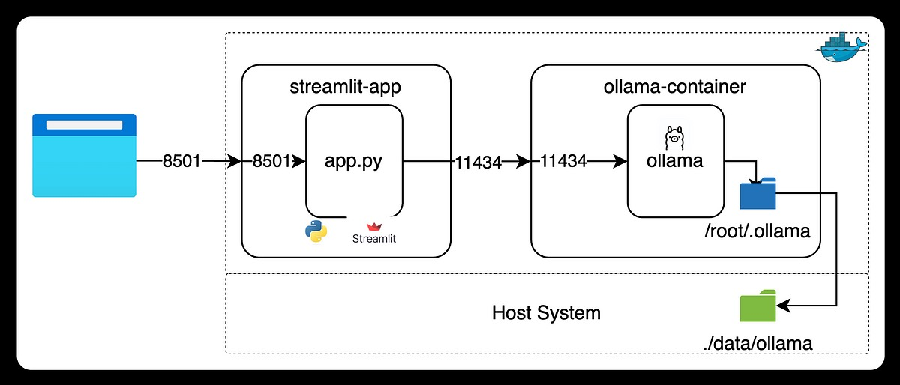

This is almost similar to the system architecture of the ollama model. However not exactly accurate as the architecture is confidential and is a private property which is not available as opensource.

Slide 21
This is the website, where the bot runs.
Here the user interacts with the website, helping it improve and is the most frontend of the projects.
This is the interactive domain that can be seen by others

Slide 22
This is the frontend of the application, built using Streamlit. (Alternatives can be used like JavaScript, php,etc)
It listens on port 8501 and accepts user input.
When a user interacts with the app (e.g., enters a prompt), the input is sent to the Ollama container.

Slide 23
These files are then sorted, modified it the ollama bot where the files are used to train the model making them more advanced and get used to the user requirements.
These are then saved into a directory where these are then easily located in cases of follow-up queries.
These are then moved to the host machine and are saved for further usage.

Slide 24
The Streamlit app and Ollama container communicate using a socket connection.
The connection is established between port 8501 on the Streamlit app and port 11434 on the Ollama container.

Slide 25
Mathematical Model
FLOW OF WORKING
User Input
NLP ( Ollama )
Backend Interaction
Error Handling

Slide 26
User Input
Chatbot primary function is to interact with user .
So , user might ask question with chatbot like :
“Book tickets for Gandhi Museum on 20 October at 7 pm.
“What are timings for Gandhi Museum ?”

Slide 27
NLP
NLP (Natural Language Processing) is an that uses ML to enable computers to understand and manipulate human language.
One advantage of using Ollama , an Open source AI Tool , is that it has inbuilt NLP Capabilities.
NLP understands User Input , and extracts Intent and Entity

Slide 28
Intent and Entity
Intent Extraction – NLP understands User Input and extract the actions Example : - Book Tickets Give Museum Details
Entity Extraction – NLP understand User Input and extracts entity and also its details Example :- Tickets(Quantity)
Date
Museum Name

Slide 29
Backend Interaction
Once NLP understands the query , it interacts with the database .
So , in our project we will use SQL Connection
So , database have entities , Museum (ID , Name , Address , Time , max_tickets)
Ticket(Id , time , date) User(id , name , age , contact , contact , mail)
Payment(transaction_id , amount)
It checks , if (max_tickets-count(tickets))>tickets requested ,
Booking proceeds further towards payment

Slide 30
Error Handling
If max_tickets-count(tickets) < tickets_requested)
Then to handle error , chatbot can display
Tickets sold out
Else , if user enters a invalid input or command (input doesn't matches the trained format ) then chat bot should return
Invalid Query or Can't understand Query

Slide 31
Thank You

